Slide 1
Published and Upcoming Regulation and Standards
Johan Guns

Slide 2
Medical Device Regulation (2017/745)
Entry into force: May 26, 2021
Replace Medical device directives 2001/83/EC, 93/42/EEG, 90/385/EEG and regulations 178/2002 and 1223/2009/EEG
Law of December 22, 2020
Royal decree of May 12, 2021
This regulation does not comply to transplants, tissues or cells of human origin, or their derivatives, covered by Directive 2004/23/EC, or products containing or consisting of them; however this Regulation does apply to devices manufactured utilising derivatives of tissues or cells of human origin which are non-viable or are rendered non-viable;
Very complex regulation
Reagents, disposables and reusable instruments are included
Equipment and software are included

Slide 3
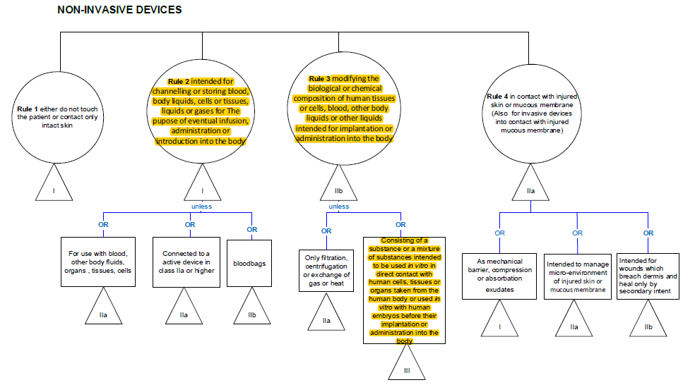
Medical Device Regulation (2017/745)

Slide 4
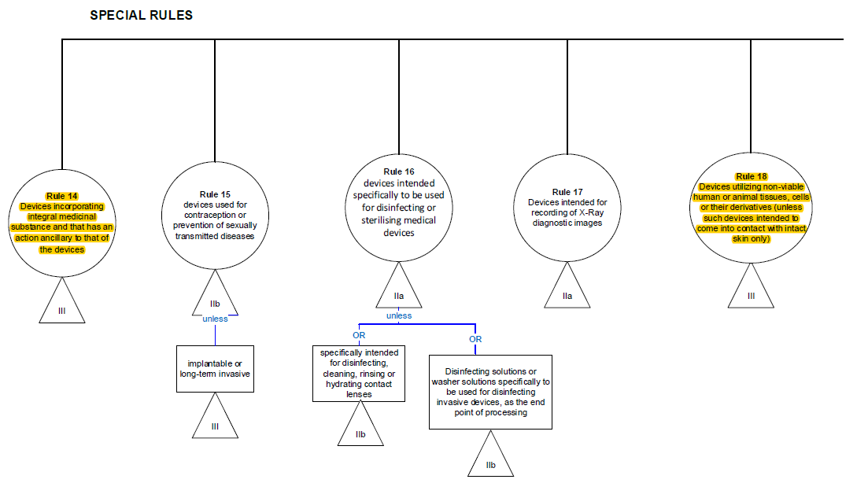
Medical Device Regulation (2017/745)

Slide 5
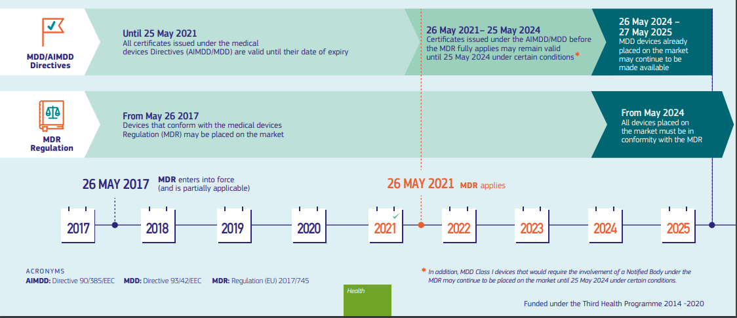
Medical Device Regulation (2017/745)

Slide 6
Medical Device Regulation (2017/745)
In-house medical devices (health care establishments)
No equivalent device exist on the market
Fulfil annex 1 of MDR 2017/745
Declaration of manufacture of in-house medical devices (FAMHP)
Compounding of more than one medical device
Compounding of medical devices with medicines
In-house developed medical device software supporting medical decisions
Substantial increase in prices
Consultation FAGG: Biovigilance/Materiovigilance

Slide 7
Medical Device Regulation (2017/745)
More information:
https://www.fagg.be/nl/menselijk_gebruik_0
https://www.afmps.be/fr/usage_humain
Manual on borderline and classification in the community regulatory framework for medical devices
https://ec.europa.eu/health/sites/default/files/md_topics-interest/docs/md_borderline_manual_05_2019_en.pdf
MDCG 2021-24 Guidance on classification of medical devices
https://ec.europa.eu/health/sites/default/files/md_sector/docs/mdcg_2021-24_en.pdf

Slide 8
EDQM 5th edition
All chapters were revised according to the latest scientific knowledge
Chapter 2. Quality management: fully revised and split up in 2 chapters:
Quality management
Risk management
Euro GTP-II
Aseptic risk assessment tool (new)
Chapter 10. Microbiological testing: fully revised in cooperation with Eur. Ph.
Table highly virulent micro-organism that could lead to tissue discard
The need for mycoplasma testing and endotoxin testing is better defined
Chapter 21. Musculoskeletal tissue
Supercritical carbon dioxide

Slide 9
EDQM 5th edition
Part C. Developing applications
Chapters breast milk, fecal microbiota and blood components for topical use will move to Part B. Tissue specific requirements
GPG and monographs
Public consultation spring of 2022
consultation period will be longer than before!
Publication EDQM guide autumn of 2022

Slide 10
Superior Health Council
HGR/CSS 9525 – Pre-analytical aspects of biological tests (draft)
Pre-mortem versus post-mortem blood samples
Hemodilution
Pooling of blood samples prior to biological testing
Storage time and stability of blood samples
Follow-up of advisory report HGR/CSS 9314 - Biological tests (2016)

Slide 11
Superior Health Council
HGR/CSS 9565 – GDPR (draft)
How does the GDPR regulation relate to the organ transplantation law and the MLM law of 2008?
Does the GDPR apply to pseudonymized or anonymized personal data related to MLM?
Does the GDPR apply in the case of donation of organs / MLM of a deceased person and with a view to medical application in humans?
Is access to personal data regulated by the GDPR? Is there a limitation in the persons who should have access to these personal data?
Is the transfer of meaningful health information to partners / family via the GP covered by the GDPR?
Advisory report submitted to the expertise center of the Data Protection Authority

Slide 12
Superior Health Council
HGR/CSS 9659 – Biovigilance: non-reproductive tissues and cells (validated, published soon)
HGR/CSS 9663 – Biovigilance: reproductive tissues and cells (draft)
HGR/CSS 9664 – Biovigilance: general considerations (draft)
March 2, 2021: FAMHP informed SHC of the revision of the procedures for the notification of SAE and SAR
FAMHP asks SHC to complement these recommendations with practical examples from day-to-day practice for clarifying the document
Common approach for definition of reportable serious adverse events and reactions as laid down in the Directive 2002/98/EC (The Blood Directive) and Commission Directive 2005/61/EC
Guidance on Vigilance and Surveillance in assisted reproductive technologies in the European Union

