Slide 1
Hightech Contract Manufacturing – Medical B.V.

Slide 2
Contents
Introduction HCM Medical
Change structure HCM Medical
  Example

Slide 3
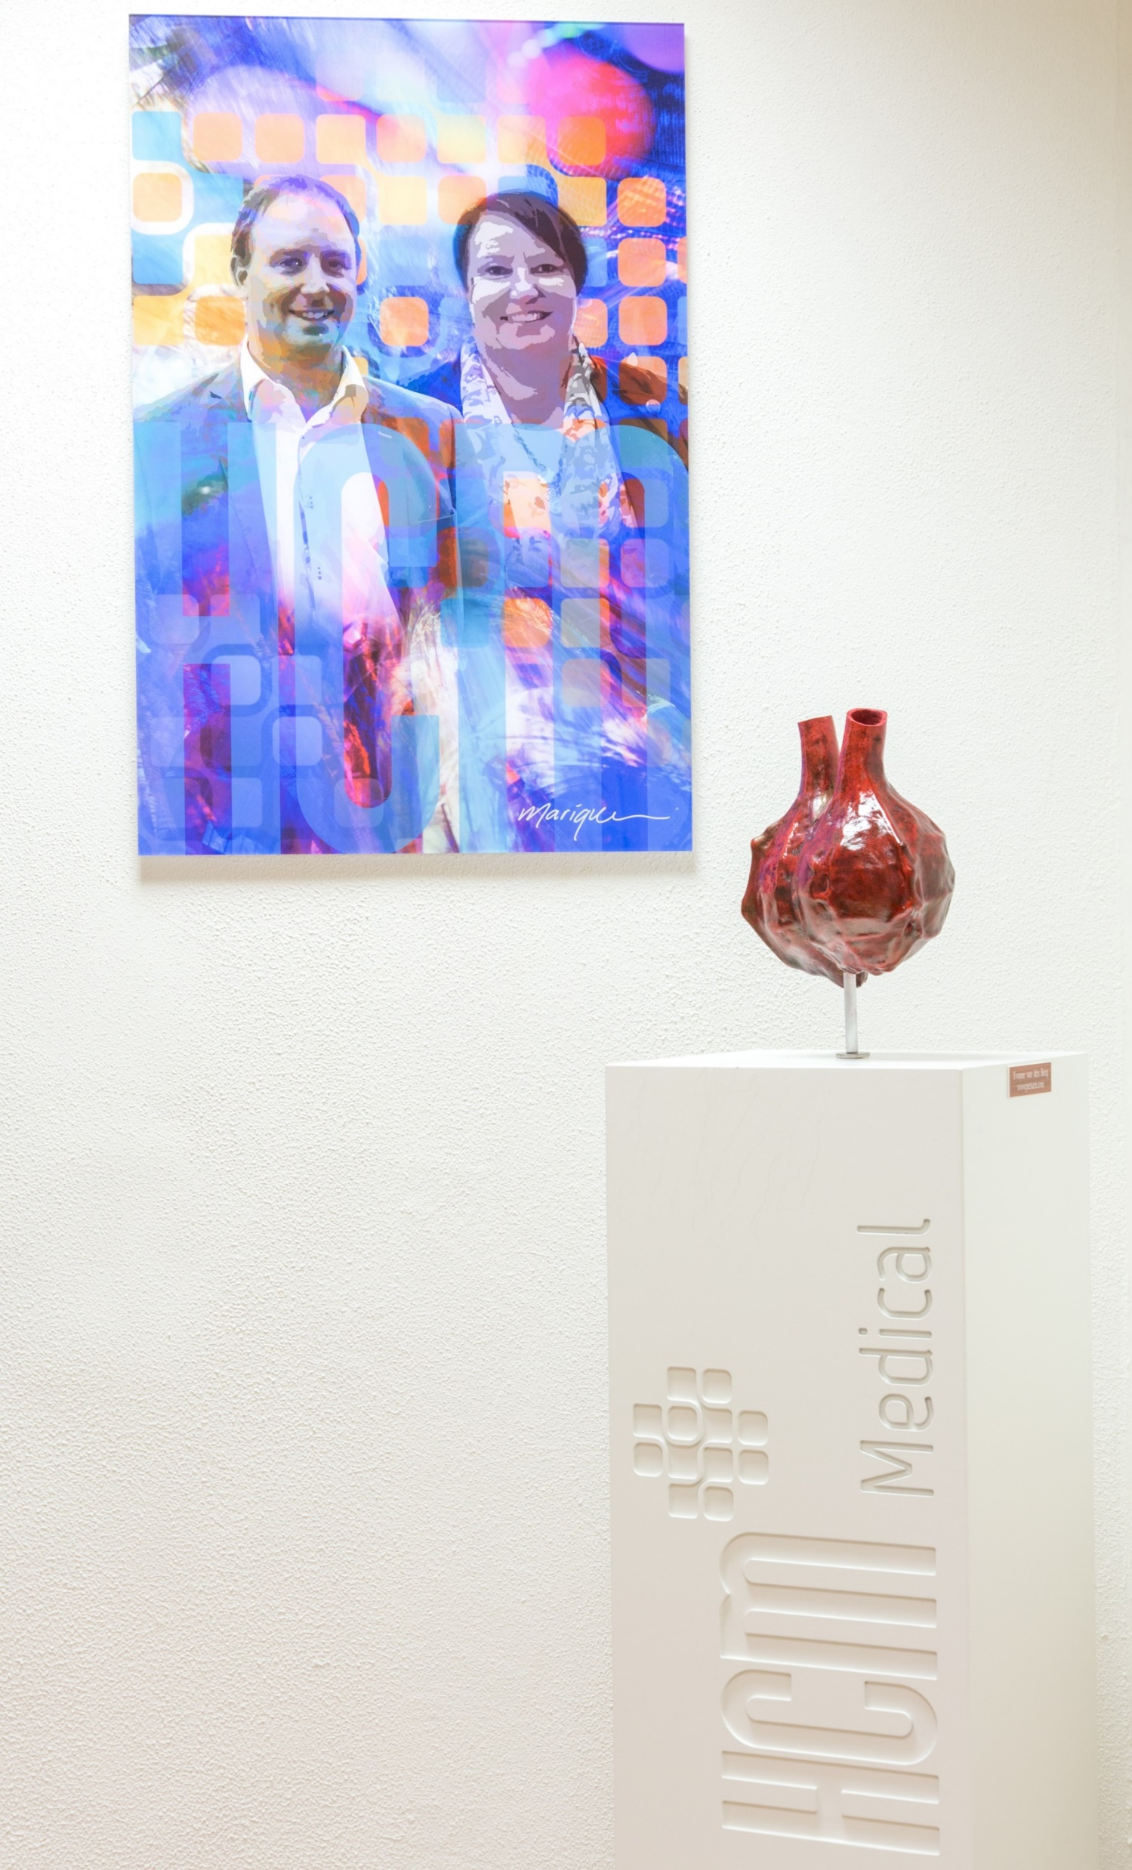
Company Mission
HCM Medical BV, is a contract manufacturer that in close collaboration with the customer develops products and implements technologies for the purpose of manufacturing unique and hightech medical products.

Slide 4
HCM Medical Contract Manufacturing Services
Together with the customer, HCM Medical specializes in the development and manufacturing of products with a biological origin; either the processing of human and animal derived tissues into new implants or the purification of biomaterials like collagen for the production of high quality implants for tissue repair.
* Business Plan 2015

Slide 5
HCM Medical Contract Manufacturing Services
Contract Manufacturing
Many companies have the need for a contract manufacturing organization, that masters the techniques and holds the appropriate licenses to manufacture these unique products.
Products or services
Production of products for customer within the current licenses, such as:
  Medical Devices (ISO 13485)
  Pharmaceuticals (GMP for IMP products)
  Tissue (human) (EU Tissue Directive)
Develop new products, in collaboration with the customer, within the
possibilities and expertise
Produce, on behalf of the customer, the first batches after product development, for clinical studies or product registration
Provide knowledge in the field of test method development
Product (process) validation
Product registration
Development
Support in production and feedback in product development
Registration
Support and feedback in regulatory processes
Commercialisation
Production, packaging and distribution

Slide 6
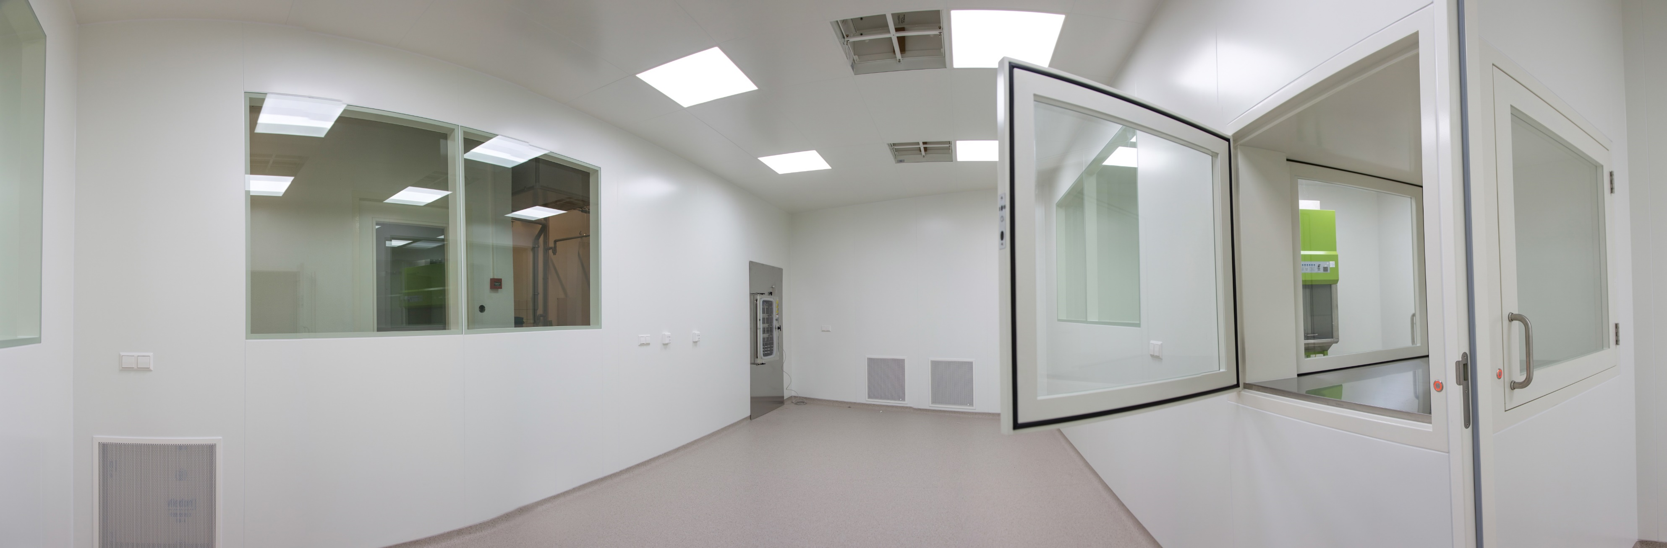
HCM Medical Technologies
Technologies performed by HCM Medical, such as:
        Supercritical CO₂ for the purpose of removal of cells and other unwanted materials from tissues.
        Freeze-drying for the purpose of production of tissue constructs.
        Collagen purification from animal derived tissues into different forms and formulations.
        Aseptic preparations; both formulating and filling under controlled aseptic conditions.

Slide 7
Change structure HCM Medical
Based on ISO 13485:
  “The organization shall identify and implement any changes necessary to ensure and maintain the continued suitability, adequacy and effectiveness of the quality management system as well as medical device safety and performance through the use of the quality policy, quality objectives, audit results, postmarket surveillance, analysis of data, corrective actions, preventive actions and management review.”
Separated in Change Request (CRF) and Document Change (CR)

Slide 8
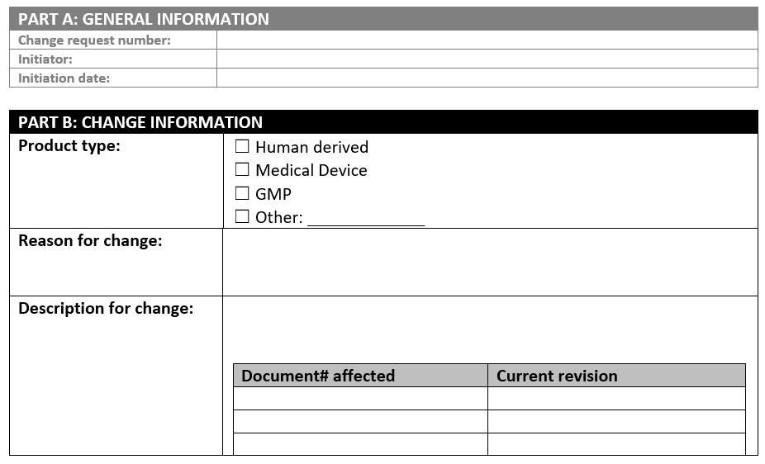
Change Request Form (CRF)
Five sections:
  General Information
  Change Information
  Change Evaluation
  Approval of Change
  Effectiveness Check and Closure of Change

Slide 9
Change Evaluation
Calibration, qualification or validation;
Procedures;
Specifications;
Artwork;
Tooling or machine equipment;
Software or controlling units;
Approved supplier list;
Training;
Customer Notification;
Regulatory status;
Notified body or other regulatory agency notification.

Slide 10
Example of change
Implementation of a new version of a product, e.g. different size

Slide 11
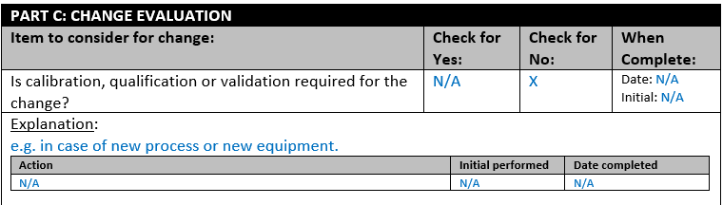
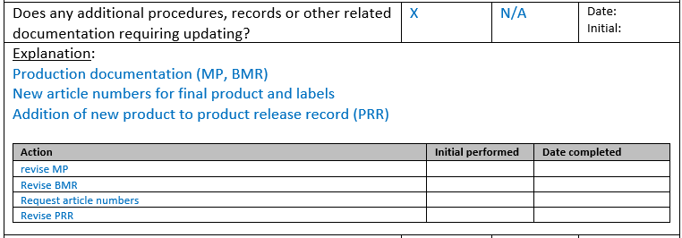
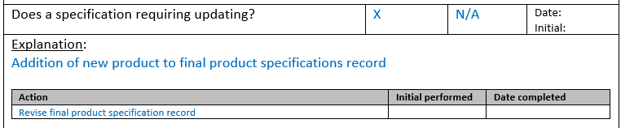
Change Request Form (CRF)

Slide 12

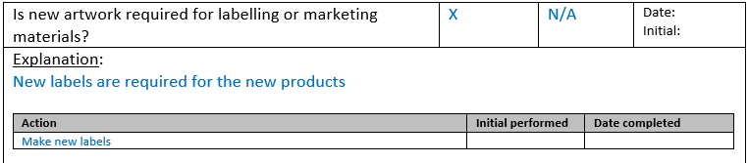
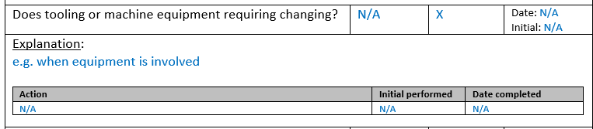
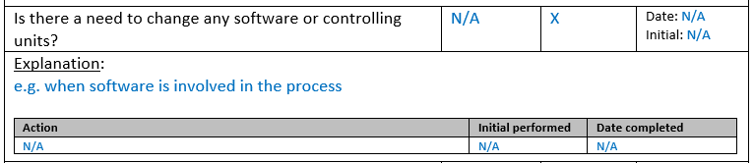
Change Request Form (CRF)

Slide 13
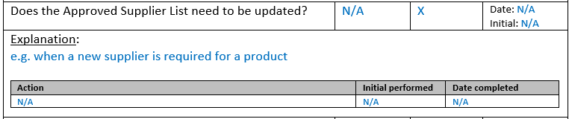
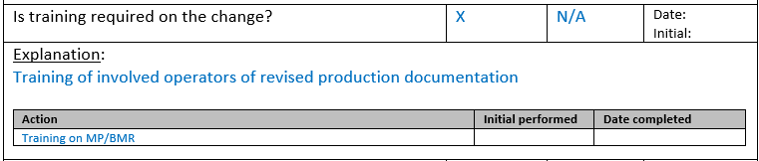
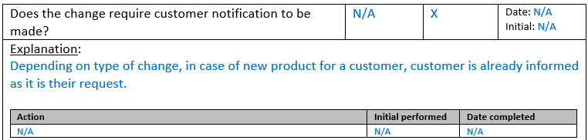
Change Request Form (CRF)

Slide 14
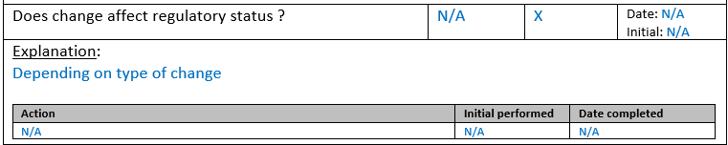
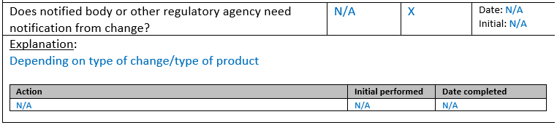
Change Request Form (CRF)

Slide 15
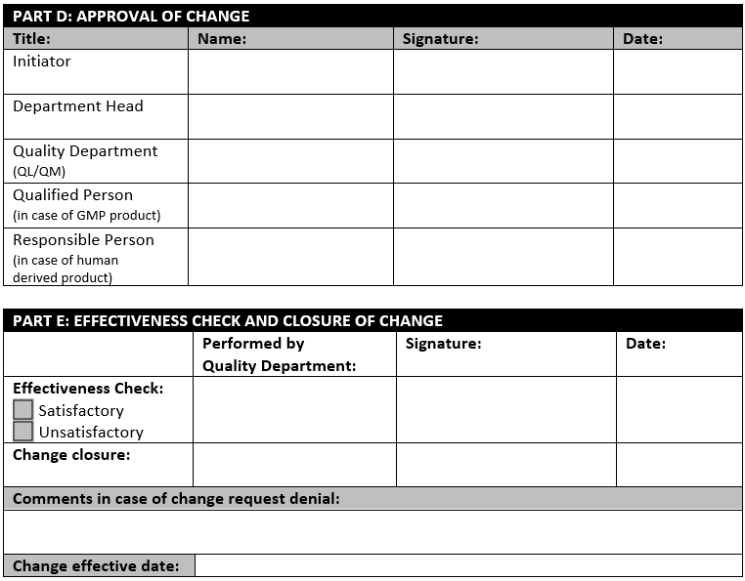
Change Request Form (CRF)

Slide 16
Hightech Contract Manufacturing – Medical B.V.

