Slide 1
Impact of the GDPR on the use of HBMs for clinical and research purposes
Superior Health Council of Belgium – Report n°9758
Belgian Association for Tissue and Cell Banks
8th Annual General Meeting
16/11/2023

Slide 2
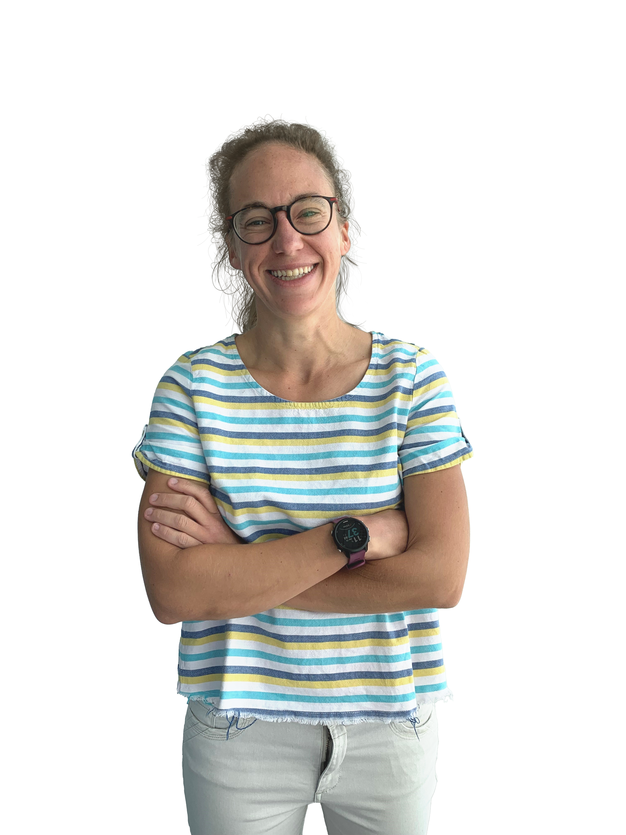
About us
Ask Q is an innovative legal venture that operates as an extension to in-house legal teams. Our consultants reinvent legal teams, optimize legal operations and offer bespoke capacity whenever they experience spikes, gaps or bottlenecks.
The Data Protection Lab aims to offer hands-on solutions for our customer’s day-to-day data protection encounters and not-so-everyday projects alike.
Laurine Delforge
Data Protection Lab Lead

Slide 3
Agenda
Introduction: GDPR and data processing by tissue and cell banks
Navigating complexity: deepdive into the SHC’s report
Conclusion

Slide 4
Introduction

Slide 5
Introduction
What does the GDPR say?
Aim: protect individuals and give them control over their personal data
Aim: improve the health of patients by ensuring the availability, safety and quality of organs, tissues and cells
Reality on the ground?
Scope: [TCB = P + PD = GDPR]
Challenges:
Time pressure: in need of rapid access to the data
Sharing is caring: in need of extensive access to the data (within/across organizations)
- Processing: any operation performed on personal data
Additional requirements for the processing of genetic, biometric or health data (Data Protection Act 30/07/2018)
Exemption for the processing of personal data for scientific research
- Personal data: any information relating to an identified or identifiable person

Slide 6
GDPR’s backbone
Risk-based approach:
level of compliance ⬄ level of risks
Accountability principle:
comply + demonstrate compliance

Slide 7
Key concern
The GDPR is not fit for purpose

Slide 8
Report n°9758

Slide 9
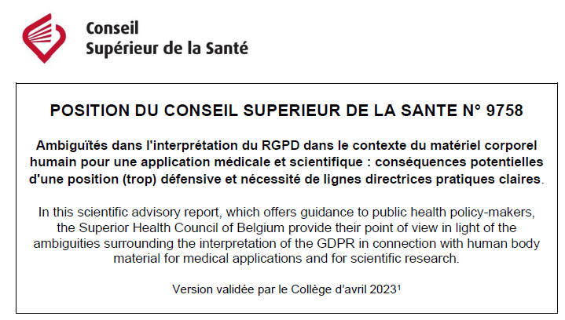
Report 9758 – GDPR & Human Body Material
Superior Health Council of Belgium, 20 April 2023
Permanent “Cells, tissues and organs of human and animal origin” Study Group

Slide 10
Question 1
How does the GDPR relate to the ODT Act and the HBM Act?
Problem
Opinion
GDPR is king (omnibus effect)
GDPR is not the law of everything
National privacy laws
Act of 30 July 2018
Sector specific laws
Act of 19 June 1986
Act of 19 December 2008

Slide 11
Question 2
Does the GDPR apply to HBM from a deceased donor?
Problem
Opinion
Recital 27: “[GDPR] does not apply to the personal data of deceased persons.”
What does “deceased” mean?
Brain death
Cardiac death
Brain death ~ Art. 11 of the Act of 13 June 1986 on the removal and transplantation of organs

Slide 12
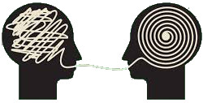
Question 3
Does the GDPR apply to associated data that are pseudonymized or anonymized?
Problem
Opinion
(Fully) anonymized data are not personal data and don’t fall under the scope of the GDPR
><
Pseudonymized data are still considered personal data and fall under the scope of the GDPR
Codes are used to preserve:
Anonymity: no link between donor and receiver
Traceability: notification requirements of serious adverse reactions and events

Slide 14
Question 4
Can health data of donors of residual HBM intended for scientific research be used without the patient’s specific consent?
Problem
Opinion
Art. 9: “Processing of genetic, biometric or health data shall be prohibited [unless] the data subject has given explicit consent”
Research biobanking: post-mortem removal of HBM = opting out ~ Art. 10 of the Act of 13 June 1986

Slide 15
Question 5
How is access to personal data regulated by the GDPR?
Problem
Opinion
Minimization principle: access restricted solely to authorised persons and only on a need-to-know basis
Security audit logs: who did what, where and when?
Reserved for “doctor only”
><
HBM banks and transplant centers = mostly non-medical employees, bound by professional secrecy

Slide 16
Question 6
How can personal data be shared under the GDPR? Which media should be used?
Problem
Opinion
Security requirement (Art. 32): “Taking into account the state of the art, the costs of implementation and the nature, scope, context and purposes of processing as well as the risk, (…) shall implement appropriate technical and organisational measures to ensure a level of security appropriate to the risk, including the pseudonymization and encryption of personal data”.
Pragmatic use of email: only quick way to exchange information (medical emergency)
Other options:
eHealth: access restrictions
Email encryption?

Slide 17
Question 7
Does the sharing of significant health data to close relatives via the GP fall within the scope of the GDPR?
Problem
Opinion
If the analysis carried out during the evaluation of aa deceased donor may have repercussions its partner/family, the bank manager must pass on this information to the GP.
The bank manager is legally obliged to do so ~ HBM Act
→ Not contrary to the GDPR

Slide 18
Question 8
Does the transfer of patient data internationally fall within the scope of the GDPR?
Problem
Opinion
EU → EU: free flow of data
EU → non-EU: under restricted conditions (Chapter V)
Operation of Eurotransplant
Adequacy decision:
Data Privacy Framework: the US ensures an adequate level of protection for personal data transferred to participating companies (self-certification)
Standard Contractual Clauses

Slide 19
Conclusions
European Health Data Space (EHDS)
Adoption of codes of conduct?

Slide 21
Thank you!
letsaskq.com
letsaskq

